Slide 1
Advanced HTTP 1
IN712 Web 3

Slide 2
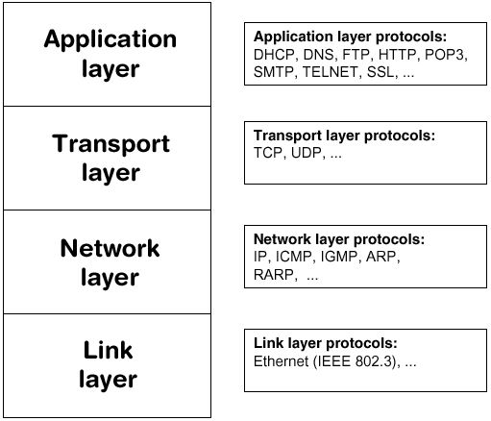
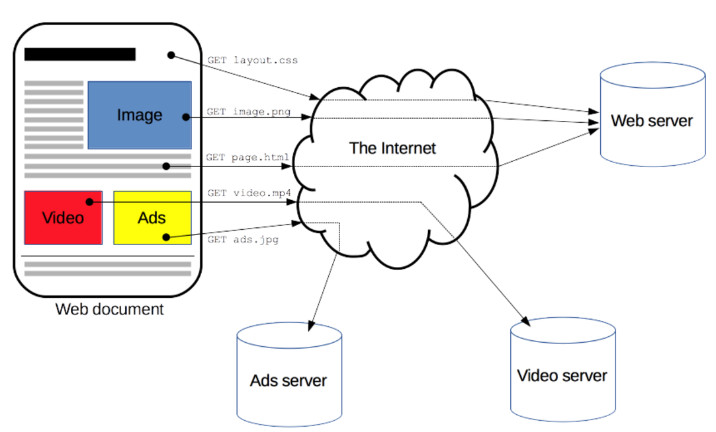
HTTP overview
Hypertext Transfer Protocol (HTTP) is an application-layer protocol for transmitting hypermedia documents, such as HTML
HTTP follows a classical client-server model, with a client opening a connection to make a request, then waiting until it receives a response.
A complete document is reconstructed from the different sub-documents fetched, for instance text, layout description, images, videos, scripts, and more.
Notes:
To present a Web page, the browser sends an original request to fetch the HTML document from the page. It then parses this file, fetching additional requests corresponding to execution scripts, layout information (CSS) to display, and sub-resources contained within the page (usually images and videos).
The Web browser then mixes these resources to present to the user a complete document, the Web page.
Scripts executed by the browser can fetch more resources in later phases and the browser updates the Web page accordingly.

Slide 3
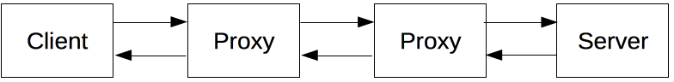
Components of HTTP-based systems
HTTP is the underlying protocol of the Web, invented by Tim Berners-Lee in 1989-1991
Clients and servers communicate by exchanging individual messages (as opposed to a stream of data)
The messages sent by the client (user agent), usually a Web browser, are called requests and the messages sent by the server as an answer are called responses.
The browser is always the entity initiating the request. It is never the server (though some mechanism have been added over the years to simulate server-initiated messages).
Between this request and response there are numerous entities, collectively designed as proxies, which perform different operations and act as gateways or caches, for example.
These can be transparent, or not (changing requests going through them or not), and may perform numerous functions:
cache
filtering (like an antivirus scan, parental controls, …)
load balancing (to allow multiple servers to serve the different requests)
authentication (to control access to different resources)
logging (allowing the storage of historical information)
Thanks to the layered design of the Web, these are hidden in the network and transport layers.
HTTP is an extensible protocol which has evolved over time.
Notes:
In 1989, while he was working at CERN, Tim Berners-Lee wrote a proposal to build a hypertext system over the Internet. Initially calling it the Mesh, it was later renamed to World Wide Web during its implementation in 1990. Built over the existing TCP and IP protocols, it consisted of 4 building blocks:
A textual format to represent hypertext documents, the HyperText Markup Language (HTML).
A simple protocol to exchange these documents, the HypertText Transfer Protocol (HTTP).
A client to display (and accidentally edit) these documents, the first Web browser called WorldWideWeb.
A server to give access to the document, an early version of httpd.
These four building blocks were completed by the end of 1990, and the first servers were already running outside of CERN by early 1991. On August 6th 1991, Tim Berners-Lee's post on the public alt.hypertext newsgroup is now considered as the official start of the World Wide Web as a public project.
The HTTP protocol used in those early phases was very simple, later dubbed HTTP/0.9, and sometimes as the one-line protocol.
Most of the time the user-agent is a Web browser, but it can be anything, for example a robot that crawls the Web to populate and maintain a search engine index
A server represents a single machine virtually: this is because it may actually be a collection of servers, sharing the load (load balancing) or a complex piece of software interrogating other computers (like cache, a DB server, e-commerce servers, …), totally or partially generating the document on demand.
A server is not necessarily a single machine, but several servers can be hosted on the same machine. With HTTP/1.1 and the Host header, they may even share the same IP address.

Slide 4
Basic aspects of HTTP
HTTP is simple
Even with more complexity, introduced in HTTP/2 by encapsulating HTTP messages into frames, HTTP is generally designed to be simple and human readable. HTTP messages can be read and understood by humans.
HTTP is extensible
Introduced in HTTP/1.0, HTTP headers made this protocol easy to extend and experiment with. New functionality can even be introduced by a simple agreement between a client and a server about a new header's semantics.
HTTP is stateless, but not sessionless
HTTP is stateless: there is no link between two requests being successively carried out on the same connection, or not. This immediately becomes problematic when users wanted to interact with a page in a coherent way, for example with an e-commerce shopping basket. Using header extensibility, HTTP Cookies are added to the workflow, allowing session creation on each HTTP request to share the same context or the same state.

Slide 5
HTTP and connections
A connection is controlled at the transport layer, and therefore fundamentally out of scope for HTTP.
Though HTTP doesn't require the underlying transport protocol to be connection-based; only requiring it to be reliable, or not loose messages. Among the two most common transport protocols on the Internet, TCP is reliable and UDP isn't.
HTTP/1.0 opened a TCP connection for each request/response exchange, introducing two major flaws: opening a connection needs several round-trips of messages and therefore is slow, but becomes more efficient when several messages are sent, and regularly sent: warm connections are more efficient than cold ones.
In order to mitigate these flaws, HTTP/1.1 introduced pipelining (which proved difficult to implement) and persistent connections: the underlying TCP connection can be partially controlled using the Connection header.
HTTP/2 went a step further by multiplexing messages over a single connection, helping keep the connection warm, and more efficient.

Slide 6
What can be controlled by HTTP
Cache
How documents are cached can be controlled by HTTP. The server can instruct proxies, and clients, what to cache and for how long. The client can instruct intermediate cache proxies to ignore the stored document.
Relaxing the origin constraint
To prevent snooping and other privacy invasions, Web browsers enforce strict separation between Web sites. Only pages from the same origin can access all the information of a Web page. Though such constraint is a burden to the server, so HTTP headers can relax this strict separation server-side, allowing a document to become a patchwork of information sourced from different domains (there could even be security-related reasons to do so).
Authentication
Some pages may be protected so only specific users can access it. Basic authentication may be provided by HTTP, either using the Authenticate and similar headers, or by setting a specific session using HTTP cookies.
Proxy and tunneling
Servers and/or clients are often located on intranets and hide their true IP address to others. HTTP requests then go through proxies to cross this network barrier. Not all proxies are HTTP proxies. The SOCKS protocol, for example, operates at a lower level. Others, like ftp, can be handled by these proxies.
Sessions
Using HTTP cookies allows you to link requests with the state of the server. This creates sessions, despite basic HTTP being a state-less protocol. This is useful not only for e-commerce shopping baskets, but also for any site allowing user configuration of the output.
Notes:
This extensible nature of HTTP has, over time, allowed for more control and functionality of the Web. Here is a list of common features controllable with HTTP.

Slide 7
HTTP flow
In client-server protocols, it is the client which establishes the connection
Open a TCP connection: The TCP connection will be used to send a request, or several, and receive an answer. The client may open a new connection, reuse an existing connection, or open several TCP connections to the servers.
Send an HTTP message: HTTP messages (before HTTP/2) are human-readable. With HTTP/2, these simple messages are encapsulated in frames, making them impossible to read directly, but the principle remains the same.
With TCP the default port, for an HTTP server on a computer, is port 80. Other ports can also be used, like 8000 or 8080. The URL of a page to fetch contains both the domain name, and the port number, though the latter can be omitted if it is 80.
Read the response sent by the server:
Close or reuse the connection for further requests.
Note that the client-server model does not allow the server to send data to the client without an explicit request for it. To work around this problem, web developers use several techniques: ping the server periodically via the XMLHTTPRequest, Fetch APIs, using the HTML WebSockets API, or similar protocols.

Slide 8
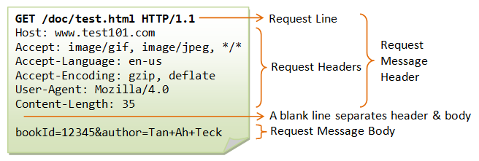
HTTP Client Request
http://www.test101.com:1234/doc/test.html?bookId=12345&author=Tan+Ah+Teck
Once the connection is established, the user-agent can send the request
A client request consists of text directives, separated by CRLF (carriage return, followed by line feed) divided into 3 blocks:
1:
An HTTP method, usually a verb like GET, POST or a noun like OPTIONS or HEAD that defines the operation the client wants to perform
The path of the resource to fetch; the URL of the resource stripped from elements that are obvious from the context, for example without the protocol (http://), the domain (here developer.mozilla.org), or the TCP port (here 80).
The version of the HTTP protocol.
2:
Optional headers that convey additional information for the servers. These HTTP headers form a block which ends with an empty line.
3:
An optional body, for some methods like POST, similar to those in responses, which contain the resource sent.
Method
Path
Version of the protocol
POST

Slide 9
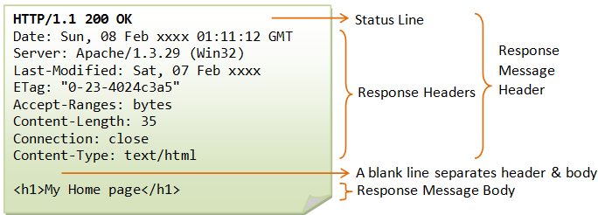
HTTP Response Syntax
The HTTP response contains:
1
A status code, indicating if the request has been successful, or not, and why.
A status message, a non-authoritative short description of the status code.
2
HTTP headers, like those for requests.
3
Optionally, but more common for requests, a body containing the fetched resource.
Version of the protocol
Status Code
Status message

Slide 10
HTTP/1.x messages and HTTP/2 Frames
HTTP/1.1 and earlier HTTP messages are human-readable.
HTTP/1.x messages have a few drawbacks for performance:
Headers, unlike bodies, are uncompressed.
Headers are often very similar from one message to the next one, yet still repeated across connections.
No multiplexing can be done. Several connections need opening on the same server: and warm TCP connections are more efficient than cold ones.
HTTP/2 introduces an extra step: it divides HTTP/1.x messages into a new binary structure, frames, which are embedded in a stream. Data and header frames are separated, this allows header compression. Several streams can be combined together, a process called multiplexing, allowing more efficient underlying TCP connections.
The semantics of each message in HTTP/2 remains unchanged and the client reconstitutes (virtually) the original HTTP/1.1 request.
It is therefore useful to comprehend HTTP/2 messages in the HTTP/1.1 format.
HTTP frames are now transparent to Web developers. This is an additional step in HTTP/2, between HTTP/1.1 messages and the underlying transport protocol. No changes are needed in the APIs used by Web developers to utilize HTTP frames; when available in both the browser and the server, HTTP/2 is switched on and used.

Slide 11
HTTP Methods
HTTP defines a set of request methods to indicate the desired action to be performed for a given resource. Although they can also be nouns, these requests methods are sometimes referred as HTTP verbs.
HTTP requests and responses follow a strict vocabulary. Each request is of a particular method or verb
GET: requests a representation of the specified resource. Requests using GET should only retrieve data.
HEAD: like GET but server returns only headers
POST: used to submit an entity to the specified resource, often causing a change in state or side effects on the server
PUT: replaces all current representations of the target resource with the request payload.
DELETE: the client wants to delete a resource
OPTIONS: the client asks the server about its supported capabilities
TRACE: the client knows how its requests arrive to the server
PATCH: used to apply partial modifications to a resource.
CONNECT: establishes a tunnel to the server identified by the target resource.
Extension methods: not defined in the HTTP specification
These http methods don't map to those actions automatically. They have to be interpreted by the web service
Not all web services are sensitive to all http methods or verbs

Slide 12
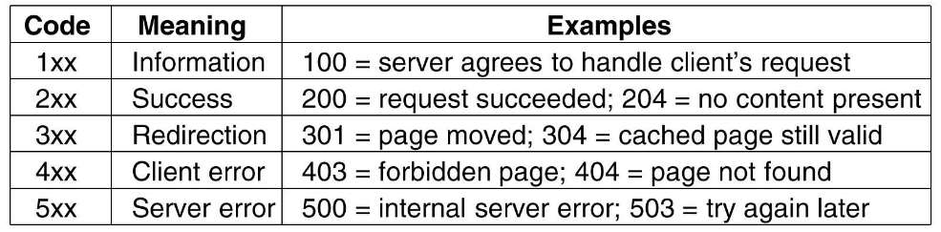
HTTP status codes
HTTP response status codes indicate whether a specific HTTP request has been successfully completed. Responses are grouped in five classes
Complete list of HTTP status codes

Slide 13
Often encountered HTTP status codes
100 Continue
This interim response indicates that everything so far is OK and that the client should continue with the request or ignore it if it is already finished.
200 OK
The request has succeeded. The meaning of a success varies depending on the HTTP method:
GET: The resource has been fetched and is transmitted in the message body.
HEAD: The entity headers are in the message body.
POST: The resource describing the result of the action is transmitted in the message body.
TRACE: The message body contains the request message as received by the server
201 Created
The request has succeeded and a new resource has been created as a result of it. This is typically the response sent after a PUT request.
202 Accepted
The request has been received but not yet acted upon. It is non-committal, meaning that there is no way in HTTP to later send an asynchronous response indicating the outcome of processing the request. It is intended for cases where another process or server handles the request, or for batch processing.
204 No Content
There is no content to send for this request, but the headers may be useful. The user-agent may update its cached headers for this resource with the new ones.
206 Partial Content
This response code is used because of range header sent by the client to separate download into multiple streams.

Slide 14
Often encountered HTTP status codes
301 Moved Permanently
This response code means that URI of requested resource has been changed. Probably, new URI would be given in the response.
302 Found
This response code means that URI of requested resource has been changed temporarily. New changes in the URI might be made in the future. Therefore, this same URI should be used by the client in future requests.
303 See Other
Server sent this response to directing client to get requested resource to another URI with an GET request.
304 Not Modified
This is used for caching purposes. It is telling to client that response has not been modified. So, client can continue to use same cached version of response.
307 Temporary Redirect
Server sent this response to directing client to get requested resource to another URI with same method that used prior request. This has the same semantic than the 302 Found HTTP response code, with the exception that the user agent must not change the HTTP method used: if a POST was used in the first request, a POST must be used in the second request.
308 Permanent Redirect
This means that the resource is now permanently located at another URI, specified by the Location: HTTP Response header. This has the same semantics as the 301 Moved Permanently HTTP response code, with the exception that the user agent must not change the HTTP method used: if a POST was used in the first request, a POST must be used in the second request.

Slide 15
Often encountered HTTP status codes
400 Bad Request
This response means that server could not understand the request due to invalid syntax.
401 Unauthorized
Authentication is needed to get requested response. This is similar to 403, but in this case, authentication is possible.
403 Forbidden
Client does not have access rights to the content so server is rejecting to give proper response.
404 Not Found
Server can not find requested resource. This response code probably is most famous one due to its frequency to occur in web.
405 Method Not Allowed
The request method is known by the server but has been disabled and cannot be used. The two mandatory methods, GET and HEAD, must never be disabled and should not return this error code.
406 Not Acceptable
This response is sent when the web server, after performing server-driven content negotiation, doesn't find any content following the criteria given by the user agent.
407 Proxy Authentication Required
This is similar to 401 but authentication is needed to be done by a proxy.
408 Request Timeout
This response is sent on an idle connection by some servers, even without any previous request by the client. It means that the server would like to shut down this unused connection. This response is used much more since some browsers, like Chrome or IE9, use HTTP preconnection mechanisms to speed up surfing (see bug 881804, which tracks the future implementation of such a mechanism in Firefox). Also note that some servers merely shut down the connection without sending this message.
410 Gone
This response would be sent when requested content has been deleted from server.
411 Length Required
Server rejected the request because the Content-Length header field is not defined and the server requires it.
412 Precondition Failed
The client has indicated preconditions in its headers which the server does not meet.
451 Unavailable For Legal Reasons
The user requests an illegal resource, such as a web page censored by a government.

Slide 16
Often encountered HTTP status codes
500 Internal Server Error
The server has encountered a situation it doesn't know how to handle.
501 Not Implemented
The request method is not supported by the server and cannot be handled. The only methods that servers are required to support (and therefore that must not return this code) are GET and HEAD.
502 Bad Gateway
This error response means that the server, while working as a gateway to get a response needed to handle the request, got an invalid response.
503 Service Unavailable
The server is not ready to handle the request. Common causes are a server that is down for maintenance or that is overloaded. Note that together with this response, a user-friendly page explaining the problem should be sent. This responses should be used for temporary conditions and the Retry-After: HTTP header should, if possible, contain the estimated time before the recovery of the service. The webmaster must also take care about the caching-related headers that are sent along with this response, as these temporary condition responses should usually not be cached.
504 Gateway Timeout
This error response is given when the server is acting as a gateway and cannot get a response in time.
505 HTTP Version Not Supported
The HTTP version used in the request is not supported by the server.

Slide 17
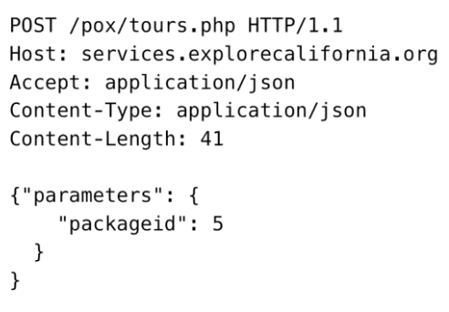
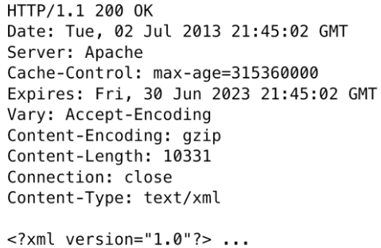
HTTP Headers
HTTP headers allow the client and the server to pass additional information with the request or the response.
A request header consists of its case-insensitive name followed by a colon ':', then by its value (without line breaks). Leading white space before the value is ignored.
Custom proprietary headers can be added using the 'X-' prefix, but this convention was deprecated in June 2012, because of the inconveniences it caused when non-standard fields became standard

Slide 18
HTTP Headers
Headers can be grouped according to their contexts:
General header: Headers applying to both requests and responses but with no relation to the data eventually transmitted in the body.
Request header: Headers containing more information about the resource to be fetched or about the client itself.
Response header: Headers with additional information about the response, like its location or about the server itself (name and version etc.).
Entity header: Headers containing more information about the body of the entity, like its content length or its MIME-type.
Notes:
Headers can also be grouped according to how proxies handle them:
End-to-end headers
These headers must be transmitted to the final recipient of the message; that is, the server for a request or the client for a response. Intermediate proxies must retransmit end-to-end headers unmodified and caches must store them.
Hop-by-hop headers
These headers are meaningful only for a single transport-level connection and must not be retransmitted by proxies or cached. Such headers are: Connection, Keep-Alive, Proxy-Authenticate, Proxy-Authorization, TE, Trailer, Transfer-Encoding and Upgrade. Note that only hop-by-hop headers may be set using the Connection general header.

Slide 19
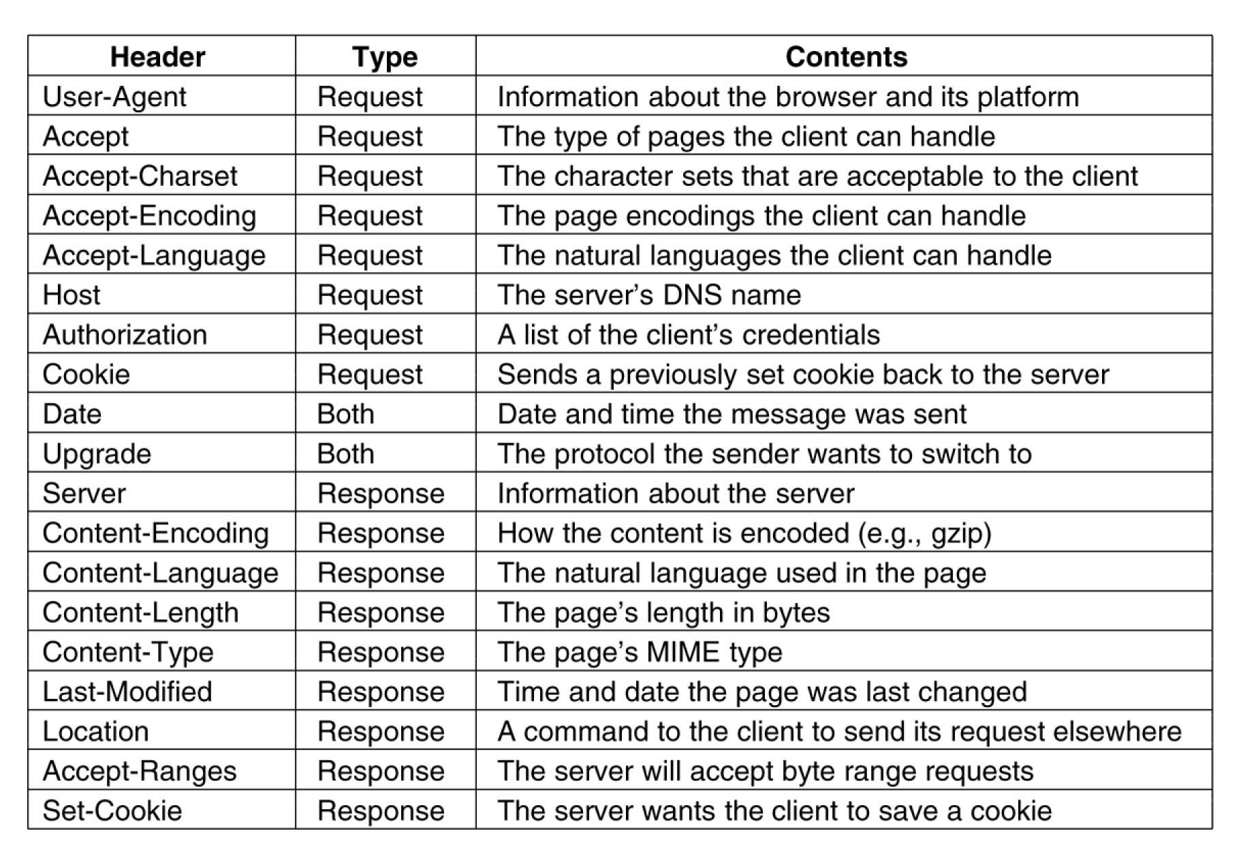
HTTP Headers

Slide 20
HTTP evolution
The initial version of HTTP had no version number; it has been later called 0.9 to differentiate it from the later versions.
HTTP/0.9 was extremely simple: requests consist of a single line and start with the only possible method GET followed by the path to the resource
The response is extremely simple too: it only consisted of the file itself. There were no status or error codes:
In HTTP/1.0 Versioning information is now sent within each request (is appended to the GET line)
A status code line is also sent at the beginning of the response, allowing the browser itself to understand the success or failure of the request and to adapt its behavior in consequence (like in updating or using its local cache in a specific way)
The notion of HTTP headers was introduced, both for the requests and the responses, allowing metadata to be transmitted and making the protocol extremely flexible and extensible.
With the help of the new HTTP headers, the ability to transmit other documents than plain HTML files was added (thanks to the Content-Type header).
In parallel to the somewhat chaotic use of the diverse implementations of HTTP/1.0, and since 1995, well before the publication of HTTP/1.0 document the next year, proper standardization was in progress. The first standardized version of HTTP, HTTP/1.1 was published in early 1997, only a few months after HTTP/1.0.
HTTP/1.1 clarified ambiguities and introduced numerous improvement
HTTP/2 was proposed as Standard in December 2014

Slide 21
More than 15 years of extensions
The environment in which HTTP is used today is quite different from that seen in the early 1990s.
HTTP's original design proved to be a masterpiece, allowing the Web to evolve over a quarter of a century, without the need of a mutiny.
By healing flaws, yet retaining the flexibility and extensibility which made HTTP such a success, the adoption of HTTP/2 hints at a bright future for the protocol.
HTTP didn't stop evolving upon the release of HTTP/2. Like with HTTP/1.x previously, HTTP's extensibility is still being used to add new features.
Notes:
The HTTP/2 protocol has several prime differences from the HTTP/1.1 version:
It is a binary protocol rather than text. It can no longer be read and created manually despite this hurdle, improved optimization techniques can now be implemented.
It is a multiplexed protocol. Parallel requests can be handled over the same connection, removing the order and blocking constraints of the HTTP/1.x protocol.
It compresses headers. As these are often similar among a set of requests, this removes duplication and overhead of data transmitted.
It allows a server to populate data in a client cache, in advance of it being required, through a mechanism called the server push.
Officially standardized, in May 2015, HTTP/2 has had much success. By July 2016, 8.7% of all Web sites^{[1]} were already using it, representing more than 68% of all requests^{[2]}. High-traffic Web sites showed the most rapid adoption, saving considerably on data transfer overheads and subsequent budgets.
This rapid adoption rate was likely as HTTP/2 does not require adaptation of Web sites and applications: using HTTP/1.1 or HTTP/2 is transparent for them. Having an up-to-date server communicating with a recent browser is enough to enable its use: only a limited set of groups were needed to trigger adoption, and as legacy browser and server versions are renewed, usage has naturally increased, without further Web developer efforts.

Slide 22
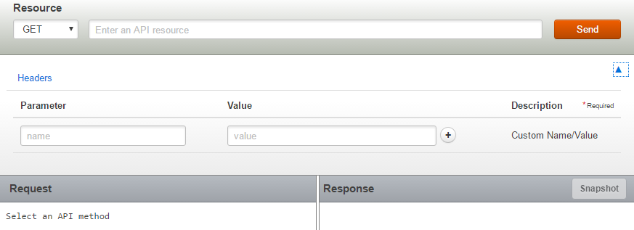
REST Console
Useful tool to study HTTP requests and response messages
https://apigee.com/console/others
Accept-Language
Sample URL: http://maps.googleapis.com/maps/api/geocode/xml?address=New%20York

Slide 23
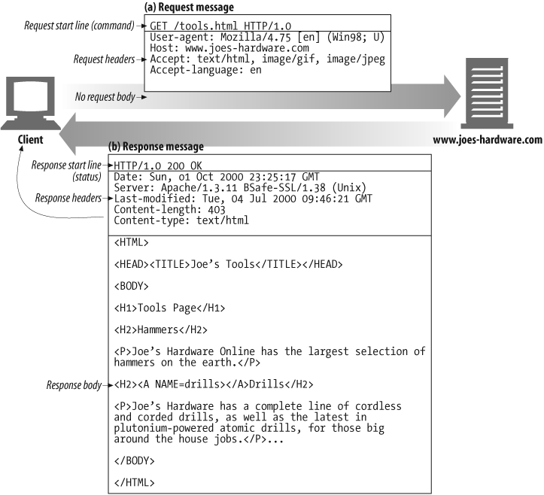
Example GET transaction
Take home message

Slide 24
References
https://developer.mozilla.org/en-US/docs/Web/HTTP

